Slide 1

QUIZKNOWS
BY: group 6:
Kristi Lavigne, aaron chance Edwards,
steven lowe II, gillian kaufman

Slide 2

What is
QUIZKNOWS?
Flashcard Website
Create
Edit
Delete
Study

Slide 3

How DOES It WORK?
LAMP STACK
Photo from: ServerGuy

Slide 4
DataBASE DESIGN

Slide 5
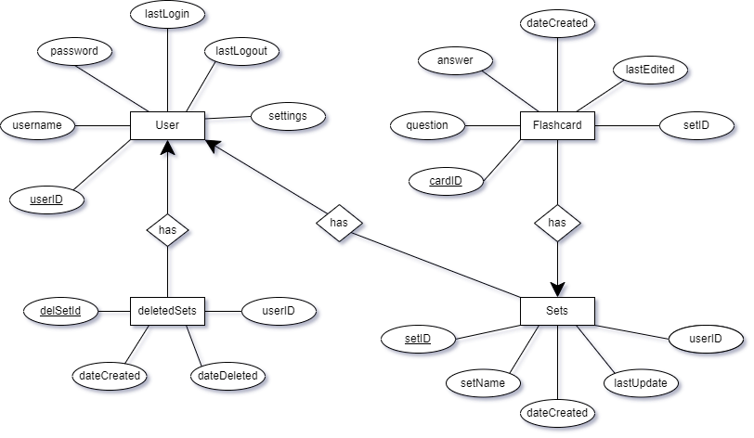

Slide 6
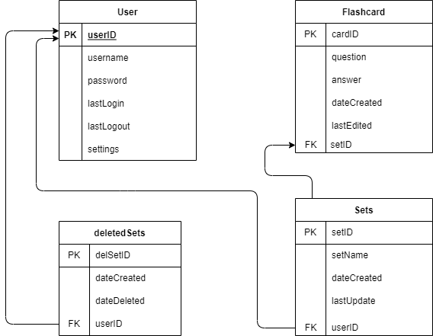

Slide 7
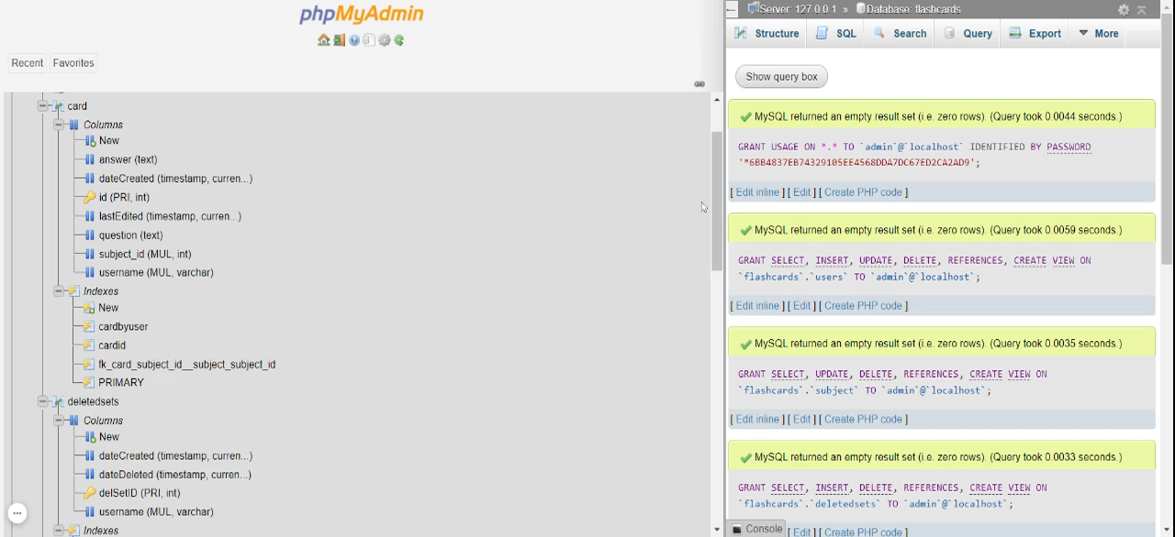

Slide 8
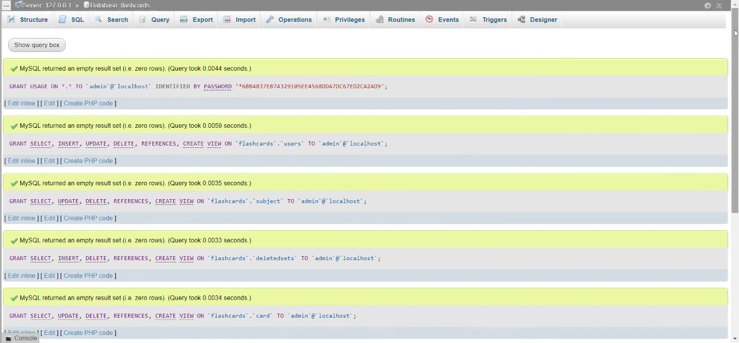

Slide 9
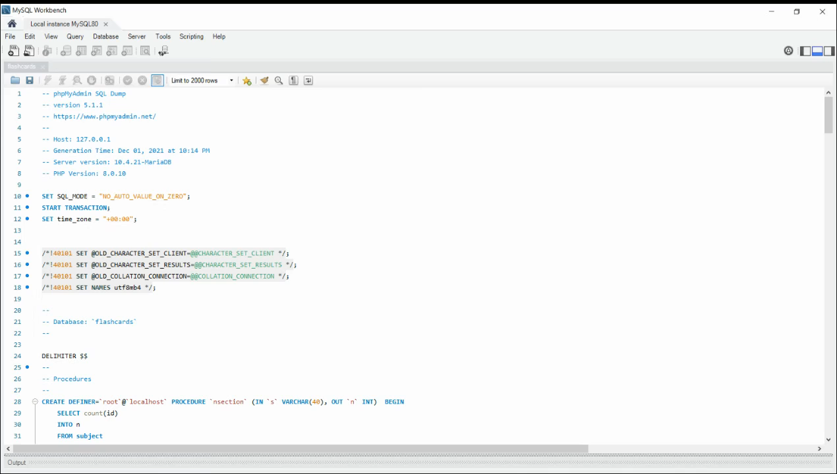

Slide 10
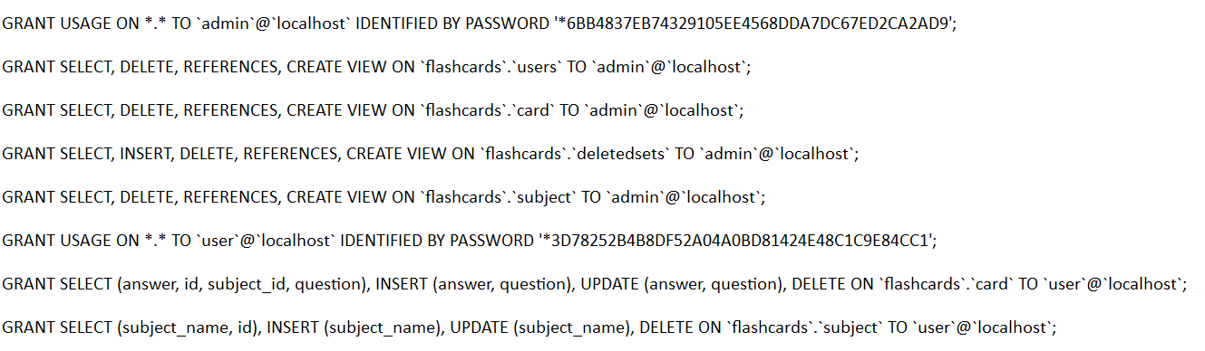
User Access Control:

Slide 11
THE CODE

Slide 12
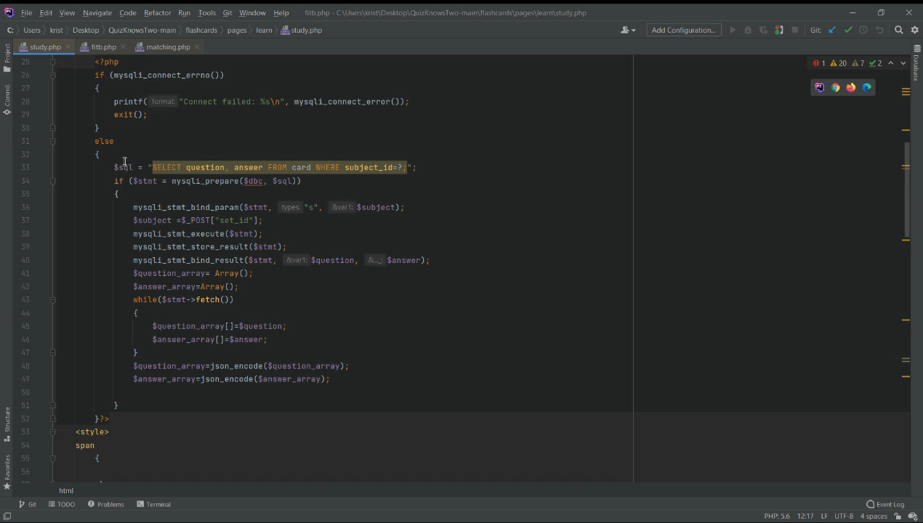

Slide 13
DEMOS

Slide 14

Notes:
JUST IN CASE! I don’t want us saying “I swear it works”, I want us to saying “That’s okay we have a video we can show you instead”

Slide 15
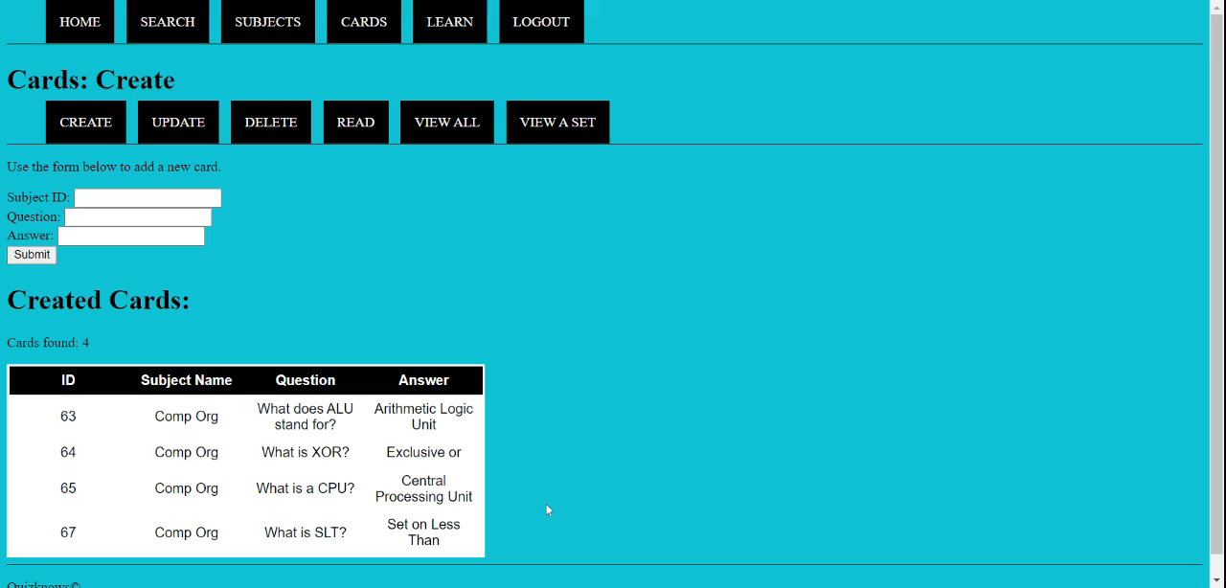
Notes:
LEARN

Slide 16

Notes:
ADMIN

